Slide 1
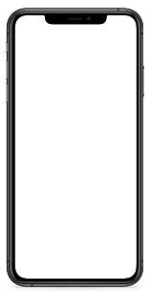
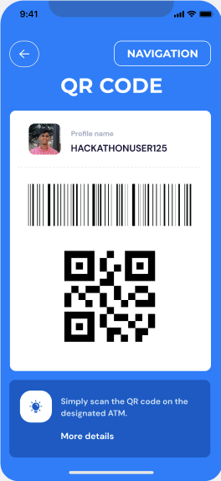
ATM-Pal
UGA Hacks 6
NCR Challenge
February 7, 2021

Slide 2

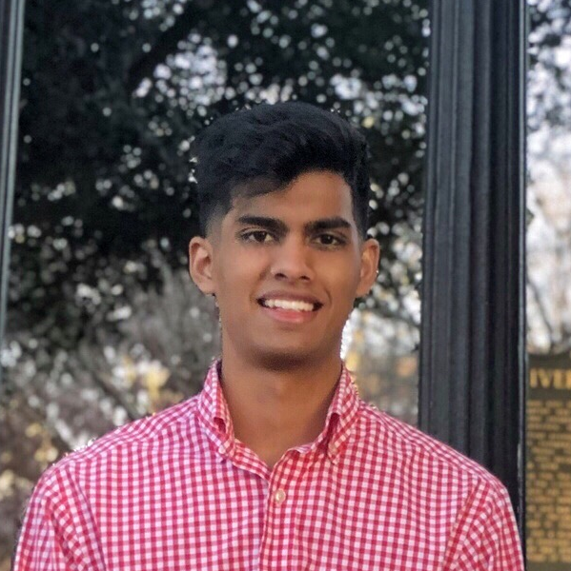

Our team
Brandon Yau
Faisal Hossain
Matthew Tzou
Computer Science, Cognitive Science
Class of 2023
Computer Science, Emphasis & Certificate: Applied Data Science
Class of 2022
Computer Science
Class of 2023

Slide 3

Problem
ATM Process:
Hard to find; inaccessible
High-exposure to germs
Long process possibly yields physically unsafe situations

Slide 4
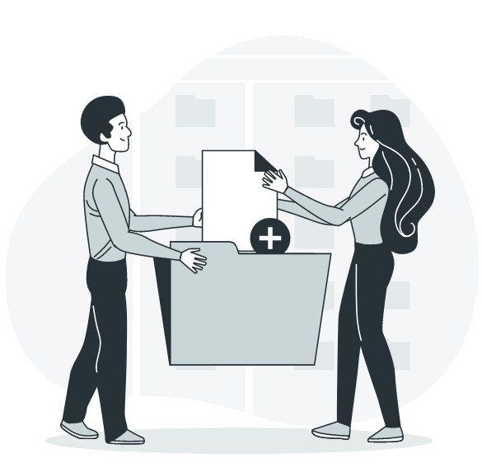
Solutions
Contact-free
Secure
Access money in a germ-free process
Digitally protected system and protocol
Efficient
Low Implementation Cost
Quick and safe ATM experience
Cost effective production

Slide 5
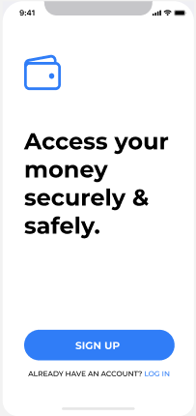
ATM-Pal
ATM-Pal redefines the conventional ATM process - without reinventing the wheel. ATM-Pals makes a trip to the ATM quicker & safer.
Notes:
Special and Inspired

Slide 6

Mock-up
Video Link

Slide 7
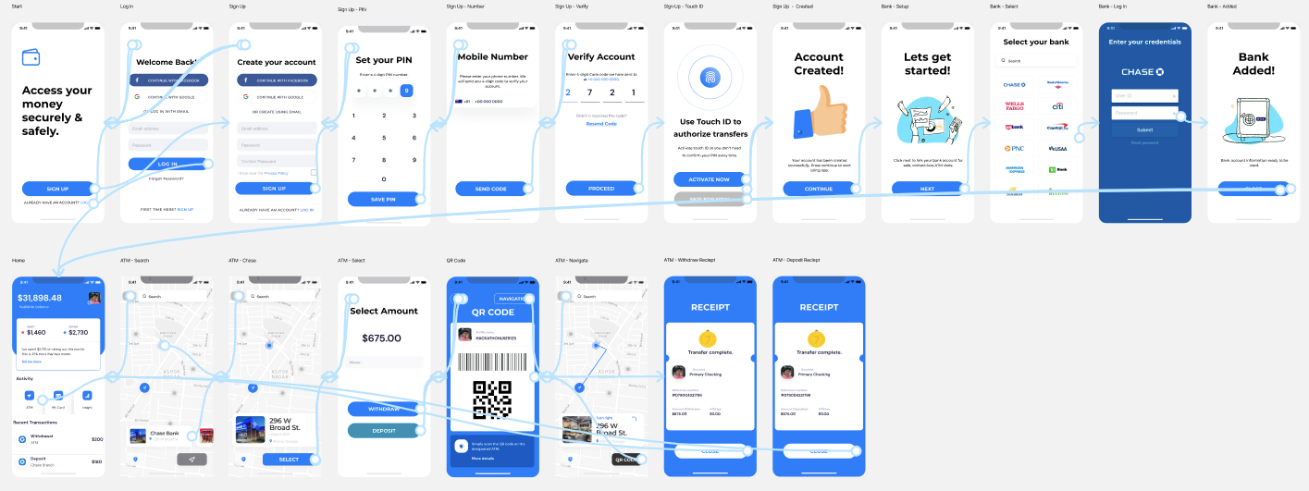
UI/UX Wireframe

Slide 8
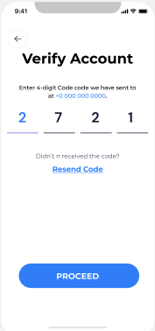
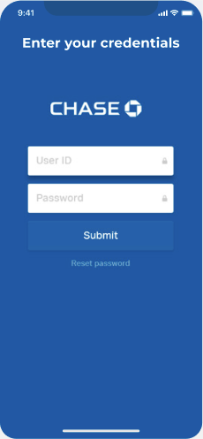
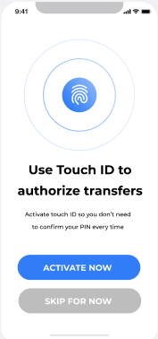
Secure
User data on ATM-Pal is secured on using two-factor authentication (2fa), touch-id, and instant bank authorization.

Slide 9
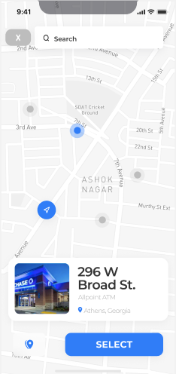
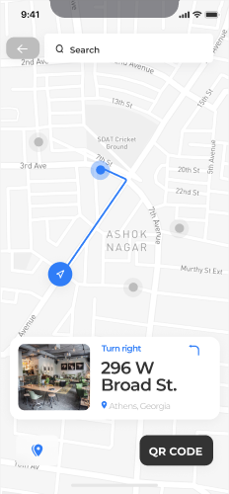
Interactive Map
ATM-Pal allows users to find nearby ATMs instantly. ATM-Pal also provides in-app navigation to ATMs.

Slide 10
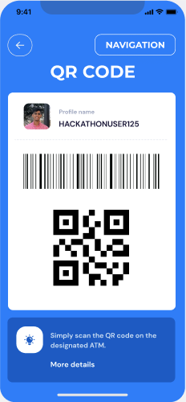
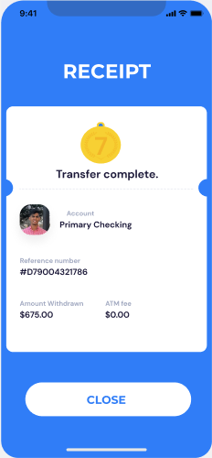
Contact-free
ATM-Pal replaces the need to touch any surface on an ATM with a fully digital process.

Slide 11
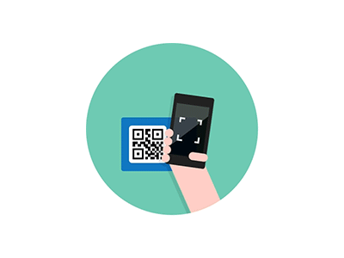
Efficient
With a speedy scan, ATM-Pal puts money in the hands of users in quick and safe fashion - reducing physical & health risks.

Slide 12
Functional Prototype
Video Link

Slide 13

Technologies Used
Hardware:
Raspberry pi 3
Camera attachment for Pi
Software:
NCR Digital Banking API
NCR Design Systems - Figma
Google Maps Static API
Postman
Python
TKinter
OpenCV
Requests
JSON

Slide 14

Development Process
API Calls | Tested NCR Digital Banking API with Postman and then implemented them into our mock ATM.
UI/UX | Designed wireframes to convey main features, functions and content of the user interface using NCR Design Systems.
GUI/API | Created a GUI that interacted with NCR Digital Banking API and our mock ATM, and integrated mock ATM inside of Raspberry Pi.

Slide 15
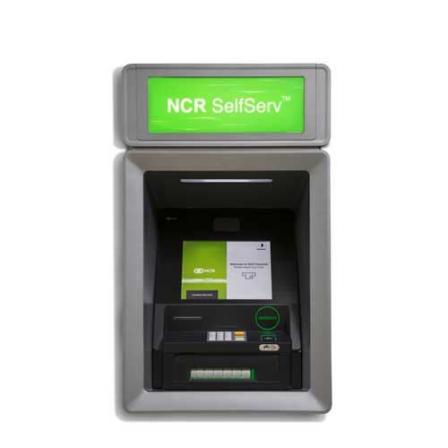
Monetization
Increase Business Traffic & Sales *
ATM Customers Spend More: ATM users spend 20-25% more in convenience stores alone
ATM Users Visit Frequently: 40% use an ATM 8-10 times a month
High Traffic: The average ATM is used 300 times per month
Low Development & Implementation Costs
Technologies needed for an ATM to be compatible for ATM-Pal is minimal
NCR SelfServ ATM
*According to National Cash Systems

Slide 16

UGAHacks Helpful Resources
Mentors
We want to give a big thanks to all the mentors as they helped us significantly and we couldn’t have gotten here without their help and advice.
NCR Workshop
NCR’s workshop was phenomenal and gave us a great understanding of their technologies as well as what we can do with it!

Slide 17
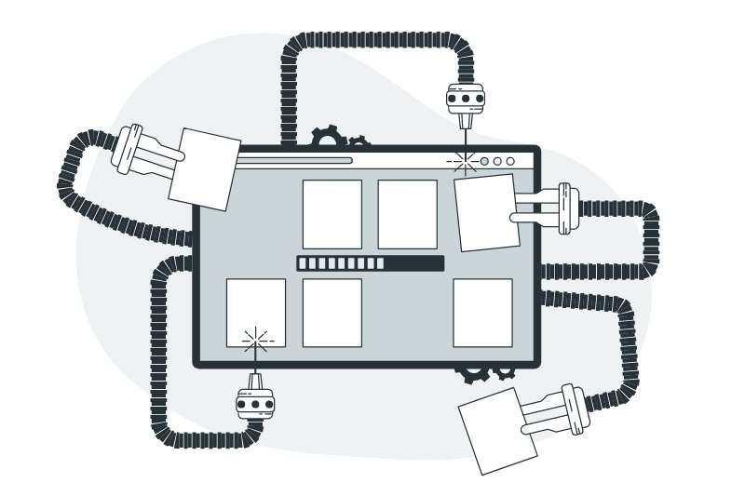
Future Ideas
IOS/Android Port
We want to port over this client-side integration to an mobile app one day.

Slide 18

Thanks!
Thank you if you have any questions, please feel free to reach out through LinkedIn (hyperlinked below).
Brandon Yau
Faisal Hossain
Matthew Tzou

